Slide 1

Our Approach
To Sentiment Analysis
Our solution utilizes machine learning algorithms for sentiment analysis, specifically focused on hotel reviews. We process review comments, classify them as positive or negative, and summarize the results using various tools, delivering clear insights for better decision-making.

Slide 2


In the competitive hotel industry, managing guest reviews is crucial for maintaining reputation and customer loyalty. However, the manual analysis and categorization of these often lengthy reviews require human intervention, is time-consuming and error-prone, making it challenging for hoteliers to quickly assess customer sentiment and address issues. There is a need for a machine learning solution that can automatically classify text reviews as positive or negative and analyze specific business features within these reviews to effectively summarize actionable insights.
Problem
Statement.

Slide 3


Develop an automated sentiment analysis system using advanced NLP techniques and machine learning algorithms, such as Random Forest Classifier, Logistic Regression, and Support Vector Machine, to accurately classify hotel reviews as positive or negative. By leveraging these ML tools to extract valuable insights from text, this solution streamlines the analysis process, providing hoteliers with actionable insights to enhance service quality and address guest concerns, ultimately improving overall customer satisfaction.
Proposed
Solution.
Faster than Manual Processing

Slide 4

But why this Approach?
CSV Upload Option:
We offer the option to upload reviews in CSV format, a widely-used standard that allows businesses to easily consolidate and analyze large volumes of reviews across various industries.
Dashboard Display
Single Review Input
We have chosen to present insights via a dashboard, a format familiar to industry analysts. Dashboards allow for a much simpler and more efficient way of visualizing data.
For businesses wanting to test the service, we provide a single text input option. This allows them to evaluate our service with minimal risk before submitting their entire dataset

Slide 5

Use Cases for Sentiment Analysis in Hospitality
Improving Guest Satisfaction
Automatically identify negative reviews that require immediate attention, allowing the hotel management to quickly address issues and improve guest satisfaction.
Staff Training and Development
Use sentiment analysis to pinpoint areas where staff performance is praised or criticized, enabling targeted training and development programs.
Personalized Marketing Strategies
Operational Improvements
Analyze positive reviews to identify common themes or amenities that guests appreciate, enabling the hotel to tailor marketing strategies around these strengths.
Detect recurring complaints in reviews (e.g., slow check-in process, noisy rooms) and use this data to make operational improvements.

Slide 6
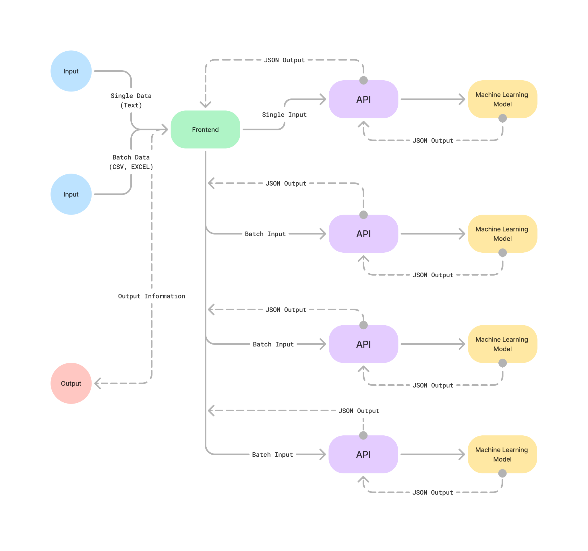

Project Overview
Process Flow:
Frontend: The user submits data through the interface.
API: Data is sent to the API, which uses the machine learning models and algorithms to process the data.
Output: The API returns the generated result as JSON.
Frontend: The frontend receives the JSON from the API and displays it on a user-friendly dashboard.
This flow ensures seamless data processing from user input to actionable insights.

Slide 7
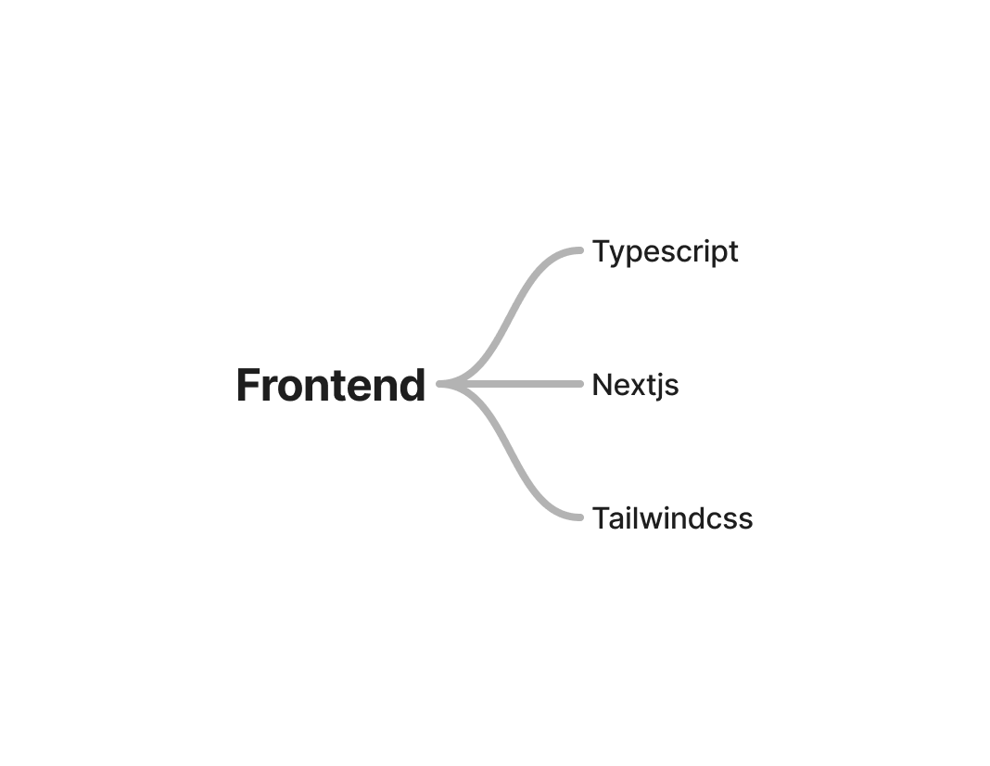




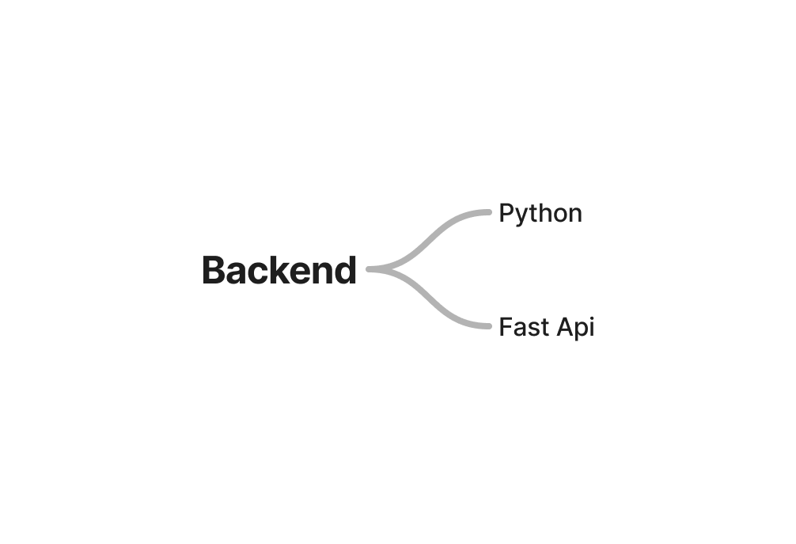



Website Tech-Stack
Typescript
Next.js
Enhances code quality and maintainability with static typing.
A popular framework that simplifies building fast websites with built-in routing features.
Python
FastAPI
Easy-to-learn language with extensive libraries that simplify integrating machine learning models into applications.
High-performance framework for building APIs quickly with minimal setup and modern Python features.

Slide 8
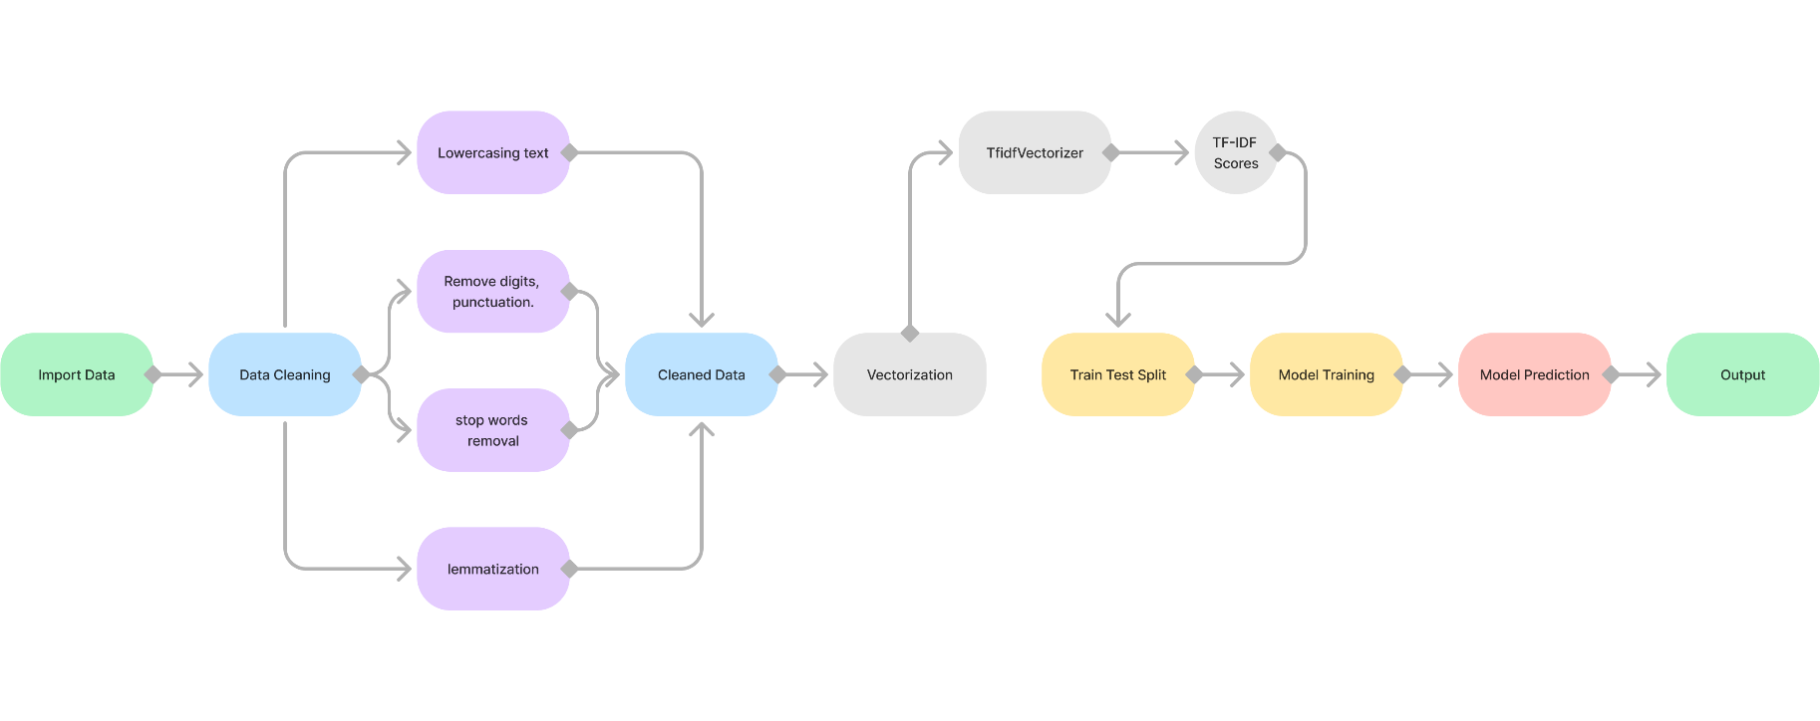


Machine Learning workflow
Machine Learning Algorithms
Logistic Regression
Random Forest Classifier
Support Vector Machine (SVM)

Slide 9




But why these Algorithms?
01
Random Forest Classifier
02
Support vector Machine
03
Logistic Regression
Simplicity & Efficiency: Easy to implement and interpret, making it ideal for quick deployment.
Training Time: Fast to train, even with a large number of features.
Performance: Handles binary classification tasks well, perfect for positive/negative sentiment.
Robustness: Combines multiple decision trees, leading to high accuracy and resilience against overfitting.
Feature Handling: Efficiently manages a large number of features without significant performance loss.
Training Time: Moderately fast, offering a good balance between training speed and predictive power.
High Accuracy: Effective for high-dimensional spaces, like text data with many features.
Generalization: Provides a good separation of classes, minimizing the risk of misclassification.
Scalability: Can be slower to train, but offers superior accuracy for complex datasets.
Captures Relevance: TF-IDF (Term Frequency-Inverse Document Frequency) highlights important words in a text, focusing on words that matter most for sentiment analysis.
Avoids Overweighting Common Words: Reduces the impact of frequently used words like "the" while emphasizing unique, sentiment-related words.
TFIDF Vectorization

Slide 10





Top 10 words used by customers to describe your business
Top Descriptors
An algorithm assigns sentiment scores to words as positive, negative, or neutral.
Sentiment Values
Features
We offer multiple classical models, all trained on real-world datasets
Model Variety
Analytics Dashboard
Interactive dashboards provide a clear, quantified view of customer sentiment, helping users better understand their perspectives.

Slide 11
Challenges in Analysis and Processing
Data Scraping
Highly Biased Data
High Training Time
Gathering data from various sources was time-consuming.
Highly positively biased data can result in inaccurate or unfair outcomes.
Large datasets need more time and heavy CPU usage for training.
Lower Accuracy than Pre-trained LLMs
Data Aggregation
Data Quality Issues
Aggregating review data in a CSV file and using it as an input may not be the best possible way.
Inconsistent or incomplete data affects analysis.
Custom models may lack pre-trained LLM accuracy.

Slide 12




Future Scope.
Enhanced Accuracy:
Integrate GenAi:
Sentiment Comparison:
Customer Sentiment Trends
Integrating advanced AI models, such as transformers for even more accurate sentiment classification.
Leveraging advanced GenAI models to offer tailored suggestions and development roadmaps.
Comparing sentiment scores across different time periods or hotel locations to identify relative performance.
Tracking how sentiment changes before and after specific events, like renovations or new service launches, to gauge their impact on guest satisfaction.

Slide 13
conclusion
This project demonstrates the effectiveness of using AI-driven sentiment analysis to streamline the evaluation of hotel reviews. By leveraging advanced NLP techniques and machine learning algorithms, we can accurately classify customer feedback, providing valuable insights to improve service quality and enhance guest satisfaction. This approach not only saves time but also enables more informed, data-driven decision-making in the hospitality industry.

